Slide 1

AI Change Management Strategies for Business Integration
am
by akshaya manoj

Slide 2
Understanding the Impact of AI on Business Operations
Increased Efficiency
Enhanced Decision-Making
Improved Customer Experiences
AI automates tasks, freeing up human resources for more strategic work, leading to faster turnaround times and improved productivity.
AI analyzes vast datasets, providing data-driven insights and predictive analytics, leading to better informed decisions.
AI personalizes customer interactions, enhances service quality, and provides real-time support, creating positive customer experiences.

Slide 3

Building an AI-Ready Organizational Culture
Embracing Innovation
Promoting Collaboration
Encourage a culture of experimentation and learning, fostering a willingness to adapt to change and explore new technologies.
Break down silos and encourage cross-functional teams to work together, fostering communication and knowledge sharing.
Developing AI Literacy
Provide training and resources to equip employees with the knowledge and skills needed to understand and work with AI.

Slide 4




Effective Communication and Employee Engagement Strategies
Transparency
Feedback Channels
Employee Empowerment
Openly communicate AI plans, benefits, and potential impacts on roles, addressing employee concerns and fostering trust.
Establish feedback mechanisms to gather employee perspectives and suggestions, allowing for continuous improvement and adaptation.
Involve employees in AI projects, giving them opportunities to contribute their expertise and feel valued, enhancing buy-in and ownership.

Slide 5




Aligning AI Initiatives with Strategic Business Goals
Vision
1
Clearly define the overall business objectives and how AI can contribute to achieving them.
Strategy
2
Develop a strategic roadmap outlining the AI projects and their alignment with key business priorities.
Execution
3
Prioritize AI initiatives based on their impact, feasibility, and alignment with business objectives.
Measurement
4
Track progress and measure the success of AI initiatives against defined metrics, demonstrating value and ROI.

Slide 6
Balancing AI and Human Capabilities in the Workplace
Augmenting Human Skills
1
AI tools can enhance human capabilities, not replace them, by automating repetitive tasks and providing insights.
Creating New Opportunities
2
AI can create new roles and opportunities, requiring human skills like critical thinking, creativity, and emotional intelligence.
Upskilling and Reskilling
3
Provide training and development programs to help employees adapt to new technologies and thrive in an AI-driven workforce.

Slide 7
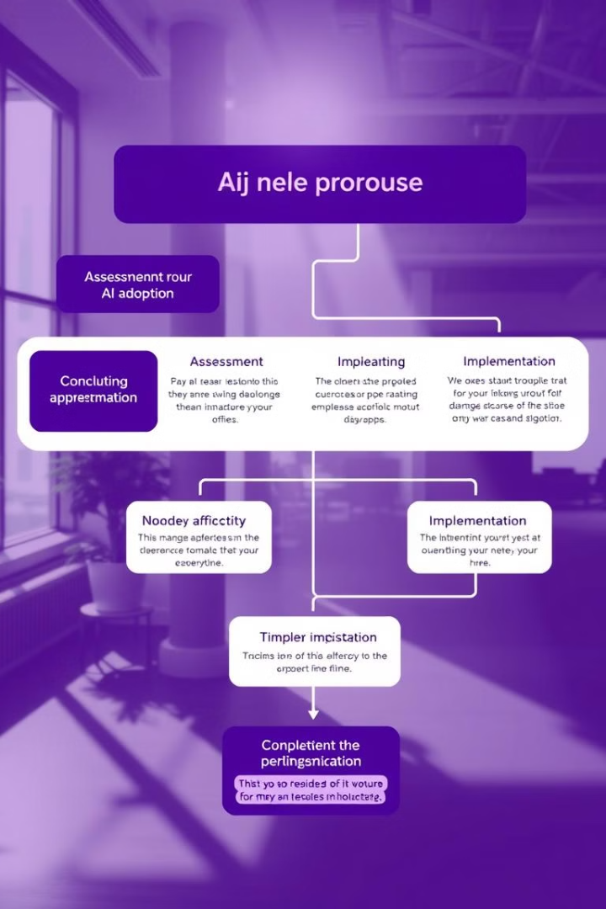
Developing a Robust AI Adoption Framework
1
Assess current processes and identify areas where AI can add value.
2
Select appropriate AI technologies based on business needs, data availability, and budget.
3
Develop a pilot program to test the feasibility and effectiveness of AI solutions.
4
Gradually scale up AI adoption, monitoring progress and making adjustments as needed.

Slide 8

Addressing Ethical Considerations in AI Integration
1
2
Bias
Privacy
Ensure fairness and transparency in AI systems, minimizing bias and promoting inclusivity.
Protect user data and privacy, adhering to regulations and ethical principles.
3
Transparency
Make AI decisions and processes understandable and explainable, building trust and accountability.

Slide 9




Integrating AI into Existing Management Models
Align AI strategies with existing management practices and processes.
Develop performance metrics and reporting systems that track AI impact and ROI.
Establish clear roles and responsibilities for managing AI projects and operations.

Slide 10



Keys to Successful AI Change Management for Sustainable Transformation

